Slide 1
JavaScript Fundamentals
Concepts, Examples, and Validations

Slide 2
Javascript Intro
JavaScript is a versatile scripting language used primarily for creating dynamic and interactive web content. It runs on the client side and can manipulate HTML and CSS, validate form inputs, and handle events.
Example:
<script> alert('Hello, JavaScript!');</script>

Slide 3
Variables
Variables store data that can be used and manipulated throughout the program. Declared using var, let, or const.
Example:
let name = "John";
const age = 25;
var isStudent = true;

Slide 4
Datatypes
Common data types include:
String , Number , Boolean , Undefined , Null ,Object ,Array
Example:
let str = "Hello";
let num = 10;
let bool = true;
let undf;
let nul = null;
let obj = { name: "Alice" };
let arr = [1, 2, 3];

Slide 5
Operators
Operators are used to perform operations on variables and values.
Includes arithmetic, comparison, logical, assignment, and more.
Example:
let x = 5 + 2; // Arithmetic
let y = x > 3; // Comparison
let z = true && false; // Logical
x += 1; // Assignment

Slide 6
Conditional Statements
Conditional statements let you make decisions in your code — you execute different blocks of code depending on whether a condition is true or false.
Control flow based on conditions using if, else if, else , switch and ternary condition

Slide 7
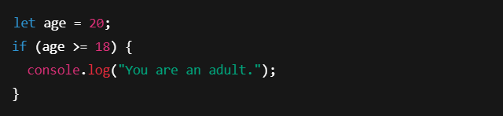
If Condition Statement
Executes a block of code only if the condition is true.
Example:
Output: You are an adult.

Slide 8
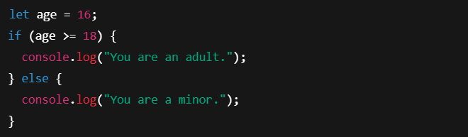
If…else Condition Statement
Executes one block if the condition is true, and another if it's false.
Example:
Output: You are a minor.

Slide 9
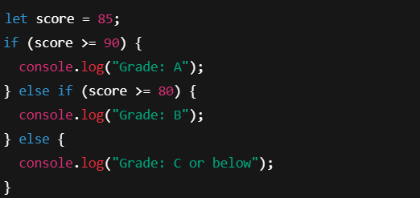
If…else if…else Statement
Checks multiple conditions in order.
Example:
Output: Grade: B

Slide 10
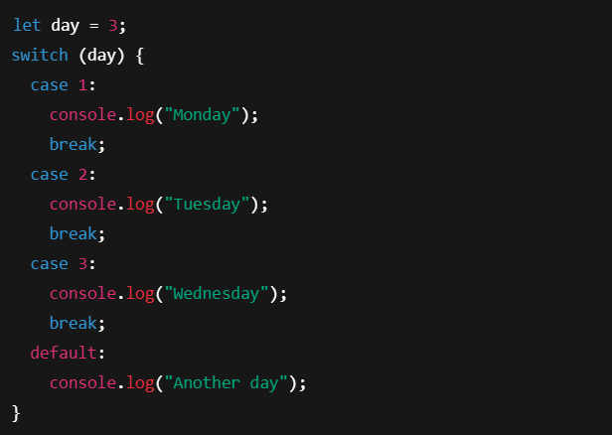
Switch Statement
Used to perform different actions based on multiple possible values of a variable.
Example:
Output : Wednesday

Slide 11
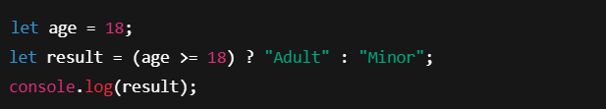
Ternary Statement
A shortcut for simple if...else. Returns one of two values based on a condition.
Example:
Output: Adult

Slide 12
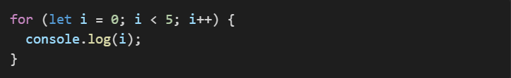
Looping Structure
Looping conditions allow you to repeatedly execute a block of code as long as a specified condition is true.
Example:

Slide 13
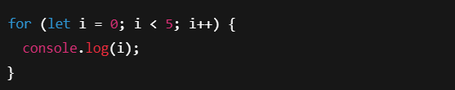
For Loop
Executes a block of code a known number of times. It includes three parts:
Initialization – runs once at the beginning.
Condition – checked before every iteration.
Increment/Decrement – updates the loop counter after each iteration.
Example:
Output : 0 1 2 3 4

Slide 14
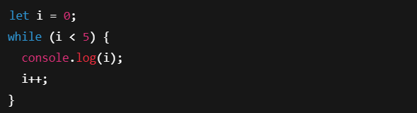
While Loop
Executes a block of code as long as the condition is true. The condition is evaluated before the loop body.
Example:
Output : 0 1 2 3 4

Slide 15
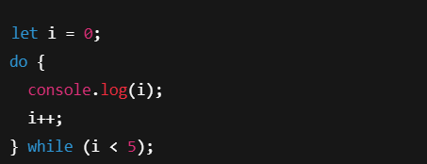
Do…While Loop
Similar to while, but the loop executes at least once, because the condition is checked after the loop body.
Example:
Output : 0 1 2 3 4

Slide 16
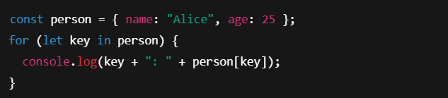
For…In Loop
Used to iterate over keys (property names) of an object
Example:
Output : name: Alice age: 25

Slide 17
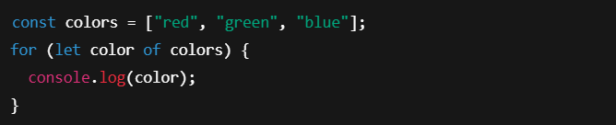
For…of Loop
Used to iterate over iterable values like arrays, strings, maps, etc.
Example:
Output : red green blue

Slide 18
Loop Control Statements
Loop control statements are used to alter the flow of loops — they let you skip, exit, or redirect iterations in a loop.
There are two main loop control statements in JavaScript:
Break
Continue

Slide 19
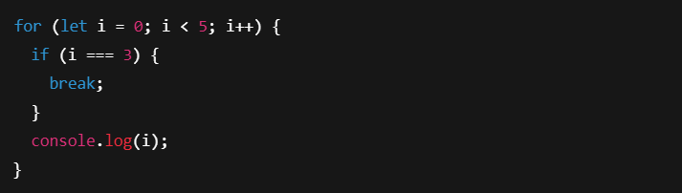
Break Statement
Immediately exits the loop.
Useful when you want to stop the loop early based on a condition.
Example:
Output : 0 1 2

Slide 20
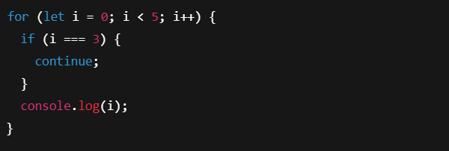
Continue Statement
Skips the current iteration and moves to the next one.
Loop does not stop, just skips that cycle
Example:
Output : 0 1 2 4

Slide 21
Array
An array is a special variable in JavaScript that can store multiple values in a single variable.
Example:
Output : apple

Slide 22
Common Array Methods
push
pop
shift
unshift
indexof
foreach
map
filter
find
join
reverse

Slide 23
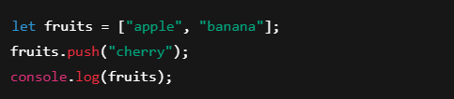
push() Method
Adds an element to the end of the array.
Example:
Output: ["apple", "banana", "cherry"]

Slide 24
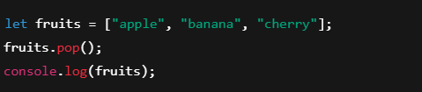
pop() Method
Removes the last element from the array.
Example:
Output: ["apple", "banana"]

Slide 25
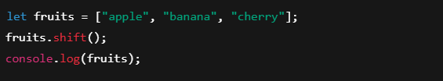
shift() Method
Removes the first element from the array.
Example:
Output: ["banana", "cherry"]

Slide 26
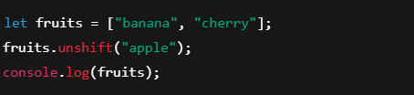
unshift() Method
Adds an element to the start of the array.
Example:
Output: ["apple", "banana", "cherry"]

Slide 27

indexof() Method
Returns the index of the specified element. Returns -1 if not found.
Example:
Output: 1

Slide 28
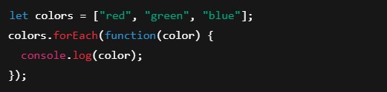
foreach() Method
Executes a function for each item in the array.
Example:
Output: red green blue

Slide 29

map() Method
Creates a new array by applying a function to each item.
Example:
Output: [2, 4, 6]

Slide 30
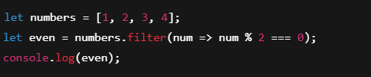
filter() Method
Returns a new array with elements that match a condition.
Example:
Output: [2, 4]

Slide 31

find() Method
Returns the first element that satisfies a condition.
Example:
Output: 6

Slide 32

join() Method
Combines all elements into a string.
Example:
Output: apple, banana, cherry

Slide 33
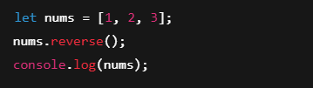
reverse() Method
Reverses the array in-place.
Example:
Output: [3, 2, 1]

Slide 34
String
Strings are used for storing text.
A string is a sequence of characters used to represent text.
Example:
let greeting = 'Hello';

Slide 35

String Methods
Common methods include length, toUpperCase(), indexOf(), etc.
Example:

Slide 36
Common String Methods
Method | Purpose
length | Get string length
toLowerCase() | Convert to lowercase
toUpperCase() | Convert to uppercase
charAt() | Get character at specific index
indexOf() | Get position of substring
includes() | Check if substring exists
replace() | Replace part of string
slice() | Extract a part using index
substring() | Similar to slice() (no negatives)
split() | Convert string to array
trim() | Remove spaces from both ends

Slide 37

length
Returns the number of characters in the string.
Example:
Output: 5

Slide 38

toUpperCase() / toLowerCase()
Converts string to upper or lower case.
Example:
Output: JAVASCRIPT javascript

Slide 39

charAt(index)
Returns the character at a specific index (starting from 0).
Example:
Output: e

Slide 40

indexOf(substring)
Returns the position of the first occurrence of a substring.
Example:
Output: 11

Slide 41

includes(substring)
Checks if a substring exists → returns true or false.
Example:
Output: true

Slide 42

replace(old, new)
Checks if a substring exists → returns true or false.
Example:
Output: Hello JavaScript

Slide 43

slice(start, end)
Extracts a section of a string.
Example:
Output: Java

Slide 44

substring(start, end)
Similar to slice() but can't accept negative values.
Example:
Output: gram

Slide 45

split(separator)
Splits a string into an array based on a separator.
Example:
Output: ["apple", "banana", "grape"]

Slide 46

trim()
Removes whitespace from both ends.
Example:
Output: "clean me"

Slide 47
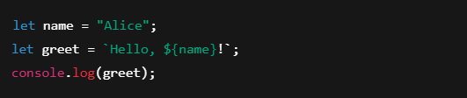
Template Strings
Allows you to embed variables using backticks ` and ${} syntax.
Example:
Output: Hello, Alice!

Slide 48
Object Intro
Objects are collections of key-value pairs.
Example:
let person = {name: 'John', age: 30};

Slide 49
Object Properties
Used to access values in an object.
Example:
let person = {name: 'John', age: 30}; person.name; // John

Slide 50
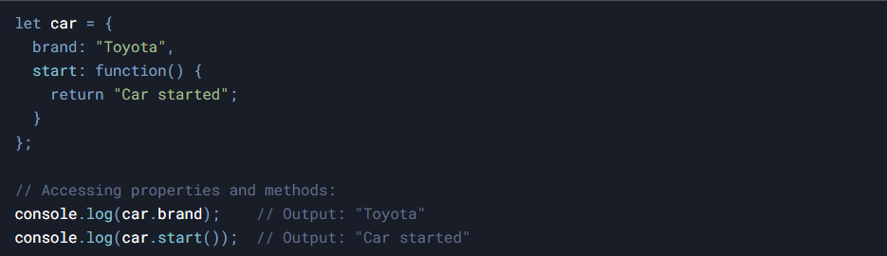
Object Method
Functions stored as object properties.
Example:

Slide 51
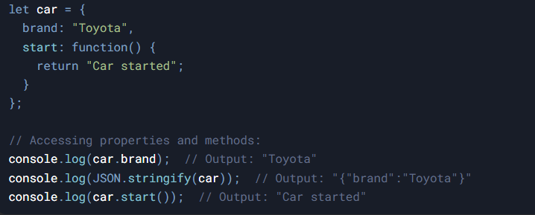
Object Display
Objects can be displayed using console.log or JSON.stringify.
Example:

Slide 52
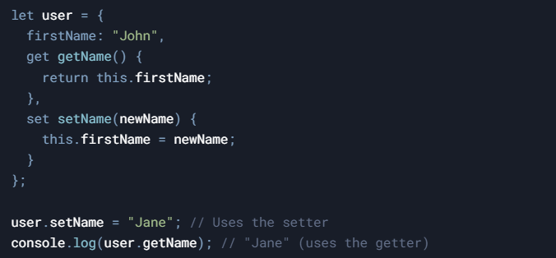
Object Accessors
Get and set properties using accessors.
Example:

Slide 53

Object Sets
Collections of unique values.
Example:

Slide 54
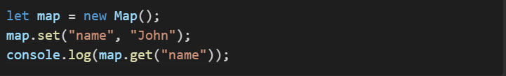
Object Maps
Maps are key-value collections like objects.
Example:

Slide 55
Function Intro
A function is a reusable block of code that performs a specific task.
You can define a function once and call it multiple times with different inputs (parameters).

Slide 56
Types of Functions
Named (Function Declaration) , anonymous, arrow functions, Constructor Function , etc.
Example:
const add = (a, b) => a + b; // Arrow Functions

Slide 57
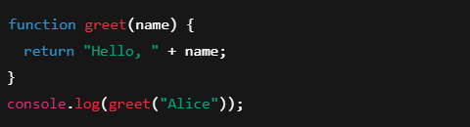
Function Declaration (Named Function)
A function defined using the function keyword.
Example:
Output: Hello, Alice

Slide 58
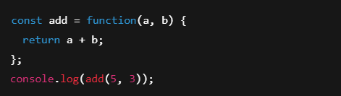
Function Expression
A function assigned to a variable. Can be anonymous or named.
Example:
Output: 8

Slide 59

Arrow Expression
A shorter syntax for writing functions using =>.
Example:
Output: 20

Slide 60
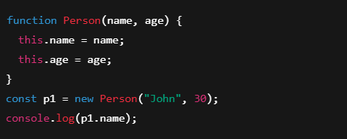
Constructor Function
Used to create objects. Naming usually starts with a capital letter.
Example:
Output: John

Slide 61
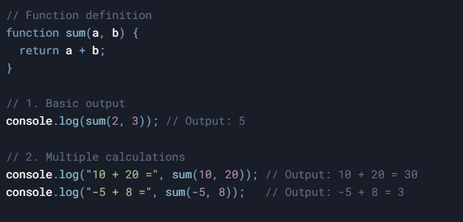
Function Parameter
Input values passed to functions.
Example:

Slide 62
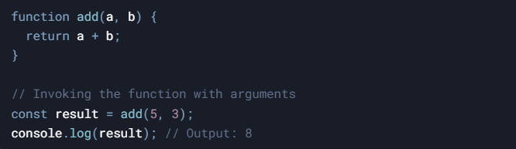
Function Invocation
Calling the function to execute.
Example:

Slide 63
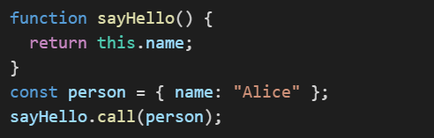
Function Call
Can be called using .call() method.
Example:

Slide 64
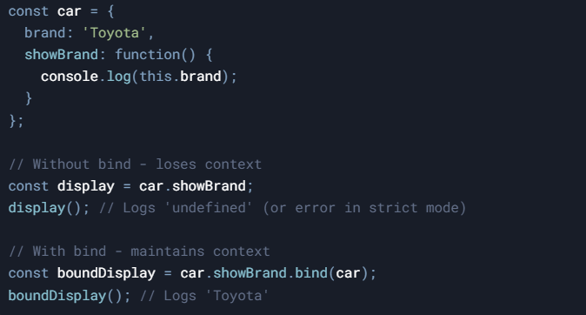
Function Bind
Creates a new function with 'this' bound to the provided value.
Example:

Slide 65
Event Handling
Used to handle events like click, submit, etc.
Example:
element.addEventListener('click', myFunction);

Slide 66
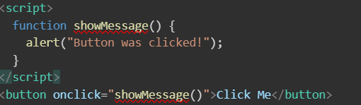
OnClick Event
Triggers when an element is clicked.
Example:
<button onclick='myFunction()'>Click</button>

Slide 67
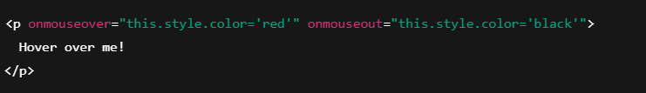
mouseover / mouseout Events
mouseover: triggers when mouse enters an element.
mouseout: triggers when mouse leaves the element.
Example:
Output: Text turns red when hovered.
Turns black again when the mouse leaves.

Slide 68
keydown / keyup Events
keydown: triggers when a key is pressed.
keyup: triggers when a key is released.
Example:
Output: In the console Key down
Key up

Slide 69
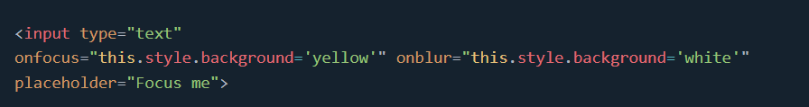
focus / blur Events
focus: when input element gets focus.
blur: when it loses focus.
Example:
Output: Background turns yellow when focused.
Returns to white when you click elsewhere.

Slide 70

dblclick Event
Triggered when the user double-clicks an element.
Example:
Output: Text changes to: You double-clicked me!

Slide 71
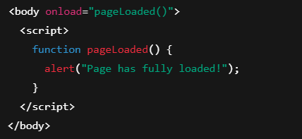
load Event
Fires when the page or an image finishes loading.
Example:
Output: Text changes to: Page has fully loaded!

Slide 72
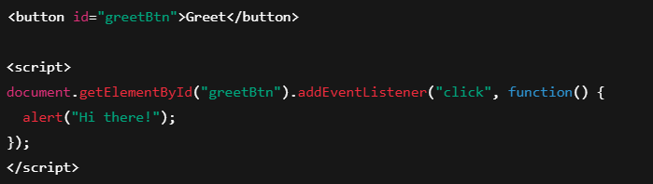
addEventListener()
The addEventListener() method attaches an event handler to a document.
Example:
Output: When button is clicked: Hi there!

Slide 73
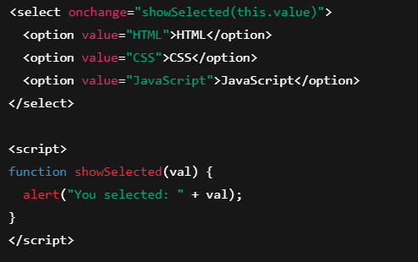
change Event
Fires when the value of an input/select changes.
Example:
Output: If you choose "CSS", it alerts: You selected: CSS

Slide 74
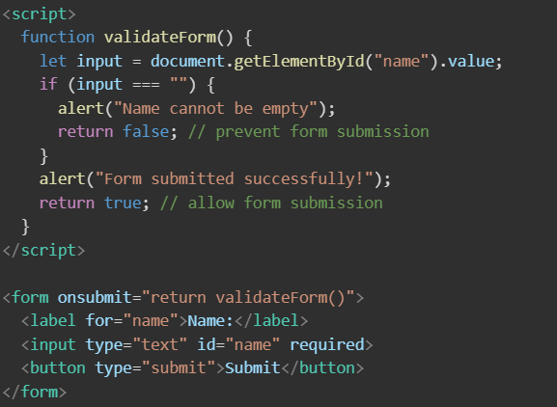
OnSubmit Event
Triggers when a form is submitted.
Example:

Slide 75
HTML DOM Documents
The Document Object
DOM - Document Object Model
When an HTML document is loaded into a web browser, it becomes a document object.
The document object is the root node of the HTML document.
The document object is a property of the window object.
The document object is accessed with:
window.document or just document

Slide 76
Why is DOM Important?
Because it lets you dynamically control your webpage using JavaScript.
For example:
Change text
Add new elements
Remove or hide content
React to user actions (clicks, typing, etc.)

Slide 77
Common DOM Methods
Purpose | Method
By ID | getElementById()
By Class | getElementsByClassName()
By Tag | getElementsByTagName()
CSS Selector (single) | querySelector()
CSS Selector (all) | querySelectorAll()

Slide 78
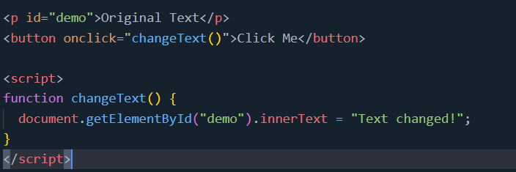
getElementById()
The getElementById() method returns an element with a specified value.
The getElementById() method returns null if the element does not exist.

Slide 79
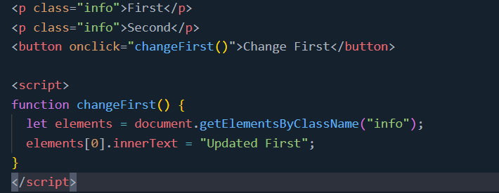
getElementsByClassName()
The getElementsByClassName() method returns a collection of elements with a specified class name(s).

Slide 80
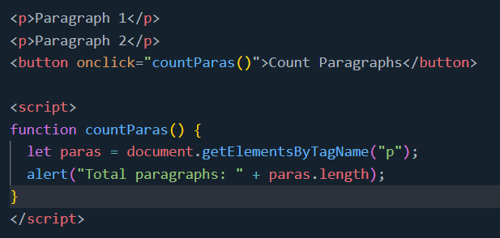
getElementsByTagName()
The getElementsByTagName() method returns a collection of all elements with a specified tag name.
The getElementsByTagName() method returns an HTMLCollection.
The getElementsByTagName() property is read-only.

Slide 81
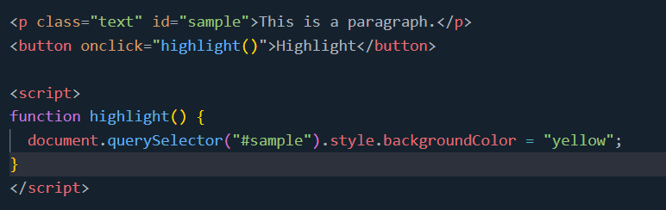
querySelector()
The querySelector() method returns the first element that matches a CSS selector.
To return all matches (not only the first), use the querySelectorAll() instead.

Slide 82
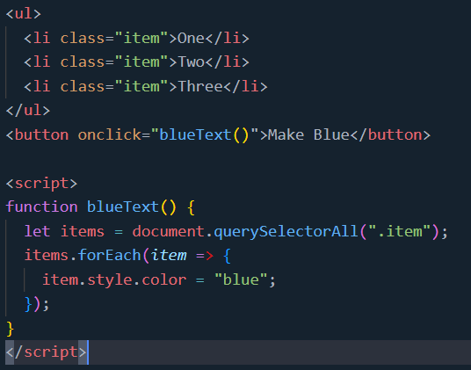
querySelectorAll()
The querySelectorAll() method returns all elements that matches a CSS selector(s).

Slide 83
JS Validation Intro
Used to ensure input is correct before submission.
Example:
if(input == '') alert('Required field');

Slide 84
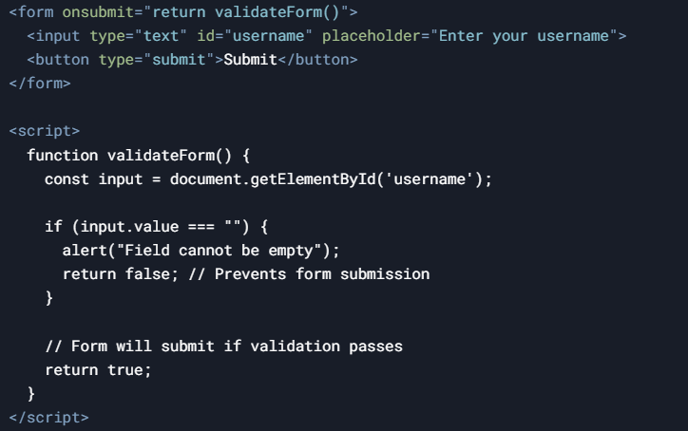
Null constraint Validation
Check if input is null or empty.
Example:

Slide 85
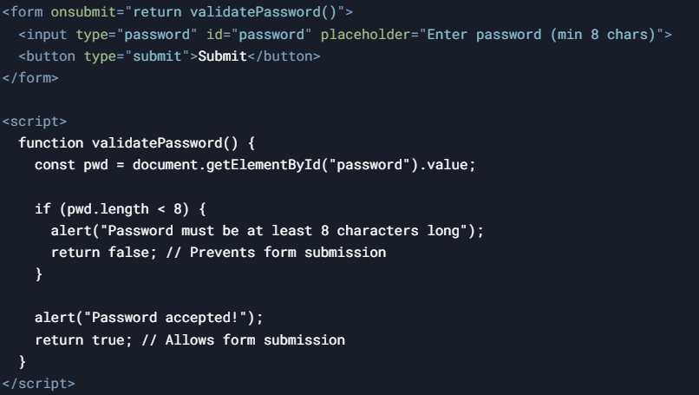
Password Validation
Ensure password meets requirements.
Example:
if(pwd.length < 8) alert('Too short');

Slide 86
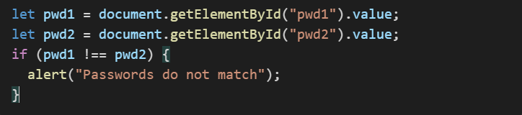
Retype Password Validation
Ensure retyped password matches.
Example:

Slide 87
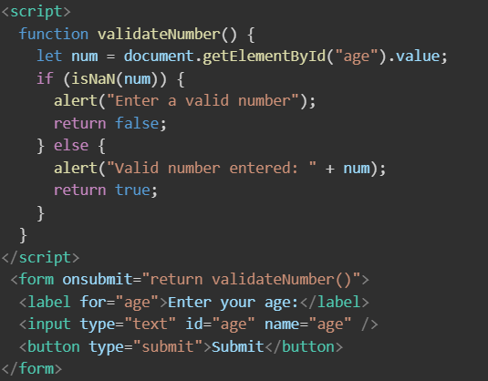
Number Validation
Checks if input is a number.
Example:

Slide 88
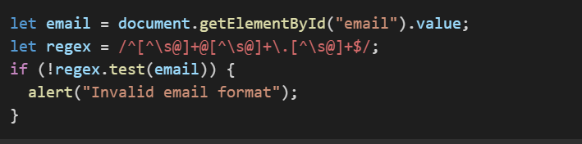
Email validation
Validate email format using regex.
Example:

